Slide 1
Cinderella
Chapter 5 Part 1

Slide 2
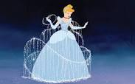
Do you remember the story of Cinderella?
She had an evil step mother who would work her unfairly and did not allow her to go to the ball to meet the prince.
But she had a fairy godmother who used magic to create a fabulous carriage, ball gown, and glass slippers.
So off she went to the ball with a
warning that the spell would
be broken at midnight!

Slide 3
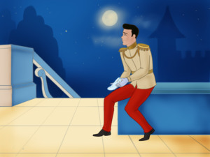
She met the prince and they fell deeply in love, but the clock struck midnight and off she ran…leaving behind one glass slipper!
Cinderella had not revealed her identity, but the prince thought that whomever would fit the shoe, would be her.
Have you wondered about all the inconsistencies in the story?
Why would one want a glass slipper to begin with?
If all the magic ended, why was the slipper left?
And how likely is it that only one maiden in ALL of the kingdom could fit in the shoe?
But if the shoe fits…..

Slide 4
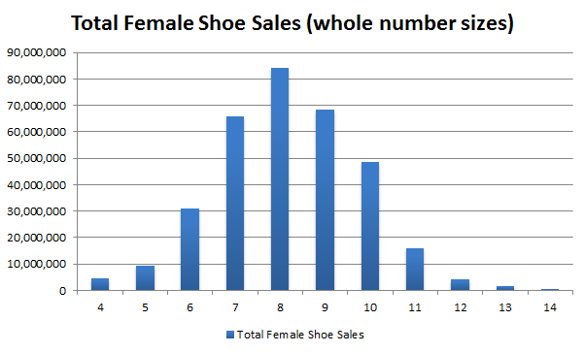
So our mission is to find out just how small would Cinderella’s shoe size have to be?
Let’s assume that women’s shoe sizes in Cinderella’s kingdom is similar to the US
We need to gather data that will show how women’s shoe sizes are distributed in the US. Below is the actual data from 2017.

Slide 5
Describe the shape.
Should the center be described using the mean or the median?
Should the spread be described using the Standard Deviation or the Interquartile Range?

Slide 6
Describe the shape.
Should the center be described using the mean or the median?
Should the spread be described using the Standard Deviation or the Interquartile Range?
The shape is fairly symmetric so we will use the mean and SD to describe the center and spread, respectively.
Using the raw data, it turns out that the mean = 8.1 and the SD = 1.5
We can sketch an approximate graph that we can use to make predictions.

Slide 7
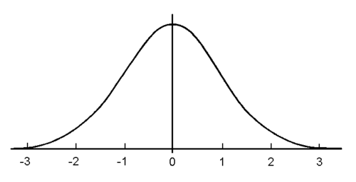
Draw a symmetric, unimodal curve called a Normal Curve
The center is the mean = 8.1
Each tick mark (z-score) is a distance of one Standard Deviation = 1.5
Add and subtract 1.5 from the center for shoe sizes
Values that are $−2<z<2$ are considered typical
Values that are $z<−3$ and $z>3$ are considered unusual
The farther from the center, the more unusual the value becomes
Z-score
3.6
5.1
6.6
8.1
9.6
11.1
12.6
Shoe Size

Slide 8
What shoe sizes would be considered typical?
What shoe sizes would be considered unusual?
Since Cinderella’s shoe size is unusually small, what do we predict about her shoe size?
Z-score
3.6
5.1
6.6
8.1
9.6
11.1
12.6
Shoe Size

Slide 9
What shoe sizes would be considered typical? Between 5.1 and 11.1
What shoe sizes would be considered unusual? Smaller than 3.6 and larger than 12.6
Since Cinderella’s shoe size is unusually small, what do we predict about her shoe size? Smaller than 3.6
Z-score
3.6
5.1
6.6
8.1
9.6
11.1
12.6
Shoe Size

Slide 10
We predicted that Cinderella’s shoe size was smaller than 3.6 to be considered unusually small
Compare this with the actual graph below. Do you think our prediction is good?

Slide 11
Normal Curve & z-scores
We can apply this concept of typical vs unusual values to make predictions for all data that is fairly symmetric

Slide 12
Let’s look at male heights
The average height of an adult male is 70 inches with a standard deviation of 4 inches. The graph is unimodal and fairly symmetric. Sketch the graph.
Remember that the center is 70 and each tick mark is a distance of 4
Z-score
58
62
66
70
74
78
82
Height

Slide 13
Let’s look at male heights
Think of a famous male who is unusually tall and one who is unusually short. Use the internet to find their heights.
Remember that the center is 70 and each tick mark is a distance of 4
Z-score
58
62
66
70
74
78
82
Height

Slide 14
Let’s look at male heights
Shaq is 7’1” or 85” tall. He is considered unusually tall since he is taller than 82”.
Kevin Hart is 5’4” or 64”. He is considered a typical height since he is between 62” and 78”.
Peter Dinklage is 4’4” or 52”. He is considered unusually short since he is shorter than 58”.
Z-score
58
62
66
70
74
78
82
Height

Slide 15
Who is more unusual?
Shaq Oneil at 85”
Peter Dinklage at 52”
To answer this question, we need to calculate each person’s z-score.
$z=\frac{data−center}{SD}$ center = 70” SD = 4”
$z=\frac{85−70}{4}$ = 3.75
$z=\frac{52−70}{4}$= -4.5
The z=score farthest from the center is the more unusual height.
Which z-score is farthest from the center?

Slide 16
The center has a z-score of 0. Peter Dinklage’s z-score is farthest from the center so he has the more unusual height
Shaq: 85”
z = 3.75
Peter: 52”
z = -4.5
Z-score
58
62
66
70
74
78
82
Height

Slide 17
Homework
Complete Quiz Chapter 1-2
Complete HW Chapter 3
Read Cinderella PP

